Slide 1
RAAS Basic physiology and Pathophysiolgy Part-I
Dr Rakesh K
SR Cardiology

Slide 2
History
In 1836 Robert Tigerstedt and Per Bergman→ kidney→hypertension→LVH.
In 1934, pathologist Harry Goldblatt→ established the first animal model of hypertension.
In 1939 -Eduardo Braun-Menendez and Irvine Page→ purified Renin and angiotensinogen.

Slide 3
Classical RAAS
When blood pressure falls, stimulates Renin release into the blood stream.
Circulating renin cleaves hepatic angiotensinogen and generates angiotensin (Ang) I
Which is converted to Ang II by pulmonary angiotensin-converting enzyme (ACE)
Angiotensin II causes
Smooth muscle cell vasoconstriction
Stimulates the sympathetic nervous system
↑thirst
Promotes renal retention of salt and water
Ang II→ release of Aldosterone,
Enhances tubular sodium reabsorption in the kidney
Increases the effective circulating plasma volume.

Slide 5
The RAAS consists of a group of enzymes and peptides.
The main function of RAAS is to control blood pressure by
Regulating vasoconstriction,
Sodium reabsorption,
Body fluid homeostasis.
RAAS is a life-saving system, which raise blood pressure by approximately 30mmHg in case of an acute hemorrhage.
RAAS is a protective mechanism of body.

Slide 6
But persistent uncontrolled activation leads to HTN and in long run end organ damage.
ACE inhibition leads to lowering in BP.
First ACEI came as antihypertensive(1970s).
Later CONSENSUS and the SOLVD trials
Showed that Enalapril reduced overall mortality in HF by 27% and 16%.
This suggested that the RAAS had significant non hemodynamic actions.

Slide 7
RAAS and Pathophysiology of heart Failure
RAAS is activated after SNS.
Causes RAAS activation
Renal hypo perfusion
Decreased filtered Na reaching distal tubule and macula densa.
Increased sympathetic activation of the kidney
Increased renin release from JGA→↑ Ang II & Aldosterone

Slide 8
↑Ang II & Aldosterone
Leads to neurohormonal activation by increasing release of NE from sympathetic nerve endings
Further increase salt and water retention
Ventricular hypertrophy
Myocardial infarction
Atherosclerosis
Induce reactive oxygen species generation
Tissue inflammation and fibrosis
The regulation of cell growth and differentiation
Apoptosis and survival

Slide 9
Various trails
HOPE trial ramipril on high risk patients.
LIFE trial losartan vs atenelol.
EUROPA and ADVANCE trials.
ONTARGET trial combined ACEI plus ARB- No added benefit.

Slide 10
RALES and EPHESUS trials
Showed that aldosterone antagonism on top of Ang II blockade provided a major additive benefit as it reduced significantly overall mortality and the rate of death from cardiovascular causes among patients with severe heart failure or after acute myocardial infarction.

Slide 11
Renin
Hormonal peptide-340 AA.
An enzyme .T½ -15 min ,prepared and stored in granular JG cells in kidney and also other tissues.
It catalyzes the rate limiting step of RAAS.
Stretch receptors (pressure sensor) in the afferent arteriole, local SNS , Na content of the tubular fluid reaching the macula Desna cell influence the release of Renin from JG cell.
Renin production is ↓ indomethacin, b-Blocker, Ang II receptor and pepstatin

Slide 12
ACE
ACE-ecto enzyme two forms
A somatic - throughout the body.
A germinal cell.
One gene chromosome 17

Slide 13
Angiotensinogen
453 amino acids
↑ by glucocorticoids, thyroid hormones, estrogens, several cytokines, Ang II.
Angiotensinogen is cleaved by Renin →inert decapeptide Ang- I.
It has 1/100th potency of Ang II.
Source of Angiotensinogen- liver, kidney, brain, heart, vascular, adrenal gland, ovary, placenta, and adipose tissue.

Slide 14
Angiotensin II
Angiotensin II one of the most potent vasoconstrictors (8 times that of NA)
Its hypertensive activity ↓in hypernatemia and cirrhosis.
Angiotensin II causes
↑adrenal cortex Aldosterone secretion.
↑ nor epinephrine by a direct action on postganglionic sympathetic neurons.
↑contraction of mesangial cells (↓ GFR).
Direct action on renal tubules to increase Na+ reabsorption.
On brain it decrease the sensitivity of the baroreflex → potentiates the pressure effect of Angiotensin II
↑H20 intake
↑Vasopressin and ACTH secretion.

Slide 15
Ang II does not penetrate the blood–brain barrier, but it triggers these responses by acting on the circum ventricular organs.
The area postrema- ↑ Blood pressure
Subfornical organ (SFO) and the organum vasculosum of the lamina terminalis (OVLT)→dispogenic effect.

Slide 16
Angiotensin II
Two main receptors: Ang II type 1 receptor (AT1R) and Ang II type 2 receptor (AT2R)
Hemodynamic actions →AT1R.
AT2R highly expressed in fetus & regulate fetal development.
AT2R also detectable in adult heart, kidney, adrenal glands, brain, ovaries and uterus, and the vessels.

Slide 17
Angiotensin II Receptors
AT1R→Chromosome 3 gene
G protein coupled receptor.
Phospholipase C [PLC]
Second messengers IP3/DAG
IP3→ ↑ cytosolic Ca2+ from intracellular store→
Vasopressor and contraction of heart
Ca/calmodulin dependent kinase [Ca2*/CMK-II] & calcinurin activation→ Modulates Gene expression
DAG→PKC→ Modulates Gene expressio→ MAPK cascade/tyrosine kinase cascade.

Slide 18
AT2R→ X chromosome
G protein/phosphatases
Antagonize growth effects
Open K+ channel
↑NO & bradykinin production
↑intracellular cGMP →↓Ca2*conc.
AT2R -plentiful in fetal /neonatal life / also in brain and other organs in adults.

Slide 19
The AT1R in the arterioles and the AT1R in the adrenal cortex are regulated in opposite ways
That is an excess of angiotensin II down-regulates the vascular receptors, but it up-regulates the adreno cortical receptors, making the gland to secrete more Aldosterone.
AT2R counterbalance AT1R by,
AT1R down regulation.
Direct inhibition of AT1R signaling.

Slide 20
AT3R action is unknown.
AT4R appears to be involved in memory acquisition and recall.
AT4R also mediate the release of plasminogen activator inhibitor 1 by Ang II.

Slide 21
Ang II can be produced by renin independent pathways.
Kallikrein and cathespin A can convert Angiotensinogen to Ang I .
Ang I → Ang II by ACE independent enzyme chymase ,which is present in mast cell.
This might be one of the link b/t RAAS system and inflammatory system.

Slide 22
Angiotensin III –has 40% of the pressure activity of Angiotensin II, but 100% of the Aldosterone-stimulating activity.
Angiotensin IV- unique euphoric effects in the brain.

Slide 25
Aldosterone
Steroid hormone. T1/2 less than 20 minutes.
Produced by zona glomerulosa of adrenal cortex.
Its main action on distal tubules and collecting duct.
Sodium retention and potassium secretion.
Place a central role in maintaining plasma sodium and arterial blood pressure.
When dysregulated, aldosterone is pathogenic and contributes to the development and progression of cardiovascular and renal disease.

Slide 26
Aldosterone secretion regulation
Four humoral factors have been shown to play important roles in the regulation of aldosterone secretion.
These are Angiotensin II, ACTH, Sodium and potassium.
Angiotensin II through RAAS .
Sodium deprivation enhances aldosterone responses to ACTH , hyperkalemia and angiotensin II.
Sodium deprivation enhances conversion of corticosterone to aldosterone.
Physiologic levels of ACTH regulate the minute-to-minute fluctuations of plasma aldosterone.
Potassium depletion decreased and potassium repletion consistently increased aldosterone excretion.

Slide 27
Aldosterone non hemodynamic actions

Slide 28
ALDOSTERONE ON HF
Salt and water retention.
Provokes hypertrophy and fibrosis within vasculature and myocardium.
Reduced compliance of vasculature
Increased ventricular stiffness.
Endothelial dysfunction
Baroreceptor dysfunction
Inhibition of NE intake.
Increase oxidative stress and activates inflammation.

Slide 29
Aldosterone escape
Seen in primary hyperaldosteronism
Is due to pressure natriuresis and increase NO and ANP in that condition.
That’s why edema is characteristically absent in primary hyperaldosteronism
Another type of aldosterone escape/aldosterone breakthrough seen in HF.
Here patient may be chronically on ACEI but aldosterone level remain elevated.
It is due to the direct stimulation of [RAAS independent] aldosterone secretion by potassium.

Slide 30
New concepts →Circulating and Tissue RAAS
RAAS was not anymore only a circulating hormonal system but also a tissue system widespread in cardiovascular organs.
Most ACE activity in the body (upto 90% )is found in the tissues ( heart, kidney, adrenal glands), remaining 10% is found in soluble form in the interstium of vessel wall.
Where they have not only endocrine but also paracrine and autocrine effects.

Slide 31
Renin, angiotensinogen, ACE, and Ang II receptors were all present in the heart.
Up regulated in cardiac injury, volume overload, myocardial infarction and heart failure.
ACE expression correlated with the size of myocardial infarction.
ACE was expressed not only in the cardiomyocytes, but also in fibroblasts, macrophages, and endothelial cells.

Slide 32
This increase in cardiac ACE was functionally significant.
It leads to increased intracardiac conversion of Ang I to Ang II.
Which could potentially impair ventricular function by inducing ventricular remodeling and eventually promoting heart failure.

Slide 33
New concepts → ACE2
ACE2 is a carboxypeptidase whose main function is to degrade Ang II to generate Ang 1–7.
Predominantly located in the endothelium of coronaries and kidneys.
ACE2 can also degrade Ang I to generate Ang 1–9, ACE2 catalytic efficiency is 400-fold higher with Ang II.
Its main effect is the degradation of Ang II to Ang 1–7
Neutral endopeptide [NEP]& prolylendopeptidase [PEP] also convert AngI & AngII to Ang 1-7.{ minor pathway}

Slide 34
Ang 1–7 is a biologically active peptide, which exerts opposite peripheral actions to those of Ang II by binding predominantly to the Mas1 receptor (Mas1R).
Ang 1–7 also acts on AT2R.
Ang 1-7 opposes Ang II action, it protects organ from unchecked actions of Ang II.
The identification of ACE2 provided evidence that the RAAS had two pathways with opposite effects.

Slide 35
ACE/Ang II/AT1R and the new ACE2/Ang 1–7/Mas1R pathway
Imbalance in classical ACE-Ang II and ACE2-Ang 1–7 is Critical in CVD development.
ACE2 is regarded as the central regulator of the RAAS.
As its changes can affect not only Ang II detrimental actions but also Ang 1–7 protective effects.
For instance, a decrease in ACE2 results in activation of the Ang II/AT1R axis with a parallel reduction of Ang 1–7.
ACE2 regulates ANP production through Ang 1–7, thereby increasing the concentration of ANP.

Slide 37
The ACE2/Ang-(1–7)/Mas axis
The ACE2/Ang-(1–7)/Mas axis counteract most of the deleterious actions of the ACE/Ang II/AT1 receptor axis.
Genetic deletion of Mas produces,
Cardiac dysfunction.
Increased blood pressure.
Decreased baroreflex function.
Endothelial dysfunction.
Reduced reproductive function
Increased thrombogenesis.
Marked changes in lipid and glucose metabolism leading to a metabolic syndrome like state.

Slide 38
New concepts → (pro)renin receptor [(P)RR]
New entry in the RAAS is the (pro)renin receptor [(P)RR], which is a specific receptor for both renin and its inactive precursor prorenin collectively called (pro)renin.
When (pro)renin binds to (P)RR it can degrade angiotensinogen to Ang I, but it can also trigger intracellular signaling pathways, which are independent of Ang II generation.

Slide 39
(P)RR gene polymorphism is associated with high BP in Japanese men
(P)RR was related to cardiovascular disease also.

Slide 40
(P)RR has essential functions related to the vacuolar H+-proton adenosine triphosphatase (V-ATPase).
Mice with specific ATP6ap2/(P)RR knockout in cardiomyocytes ,died of severe heart failure within 3 weeks of age.
(P)RR is also an essential partner in Wnt receptor complex signaling.
Which regulates normal pattering of the embryo, and in adults, cell proliferation, migration, polarity, and tissue repair.

Slide 43
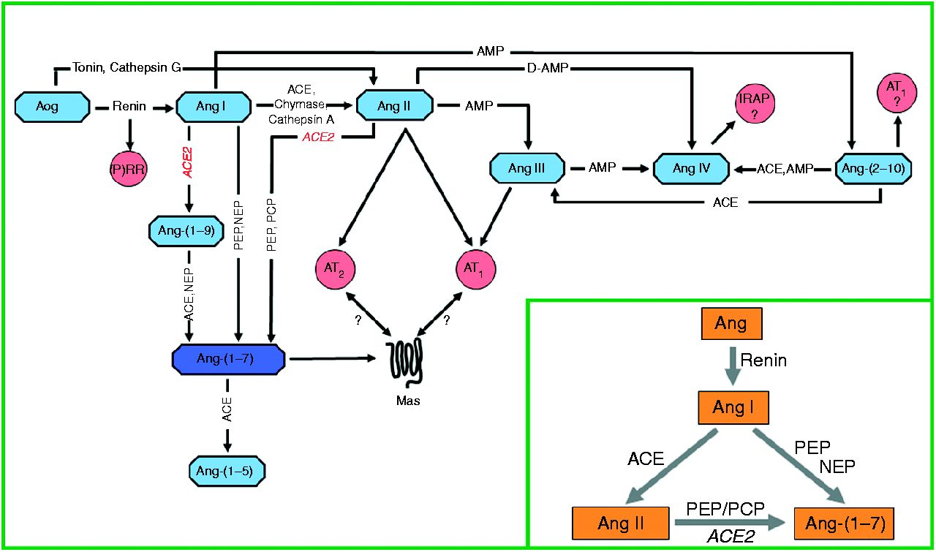
Figure 1 Detailed representation of the renin–angiotensin system cascade.
Robson A S Santos et al. J Endocrinol 2013;216:R1-R17
© 2013 Society for Endocrinology
Notes:
Detailed representation of the renin–angiotensin system cascade. The metabolic pathways involved in the generation of the main products of this system are focused in the insert. ACE, angiotensin-converting enzyme; Ang, angiotensin; Aog, angiotensinogen; AMP, aminopeptidase; AT₁, Ang II type 1 receptor; AT₂, Ang II type 2 receptor; Mas, Ang-(1–7) receptor; D-Amp, dipeptidyl-aminopeptidase; IRAP, insulin regulated aminopeptidase; PCP, prolylcarboxypeptidase; PEP, prolylendopeptidase; NEP, neutral endopeptidase 24.11; (P)RR, (pro)renin receptor.

Slide 44
Classical and new therapeutical options
ACEI
ARB
Direct renin inhibitors
Aldosterone Inhibition.
Mineralocorticoid-receptor antagonists
Aldosterone synthase (CYP11B2) inhibitors- LCI699
Angiotensin Receptor-Neprilysin Inhibition (ARNis)- Valsartan with the neprilysin inhibitor Sacubitril
(P)RR antagonist- HRP (“handle region” peptide)

Slide 45
Latest in queue
Ang 1–7 administration- Ang 1–7 bioencapsulated in plant cells.
Mas1R agonist- AVE0991
AT2R agonists- Compound 21 (C21)
ACE2 Replenishing Strategies
Adenoviral ACE2 gene transfer,
Recombinant human ACE2 (rhACE2),
ACE2 activators,
Oral ACE2.

Slide 46
Conclusions
The RAAS has been studied for more than a century.
But still the current picture of the RAAS is that of an extremely complex pathway.
What we do know is to block Ang II harmful effects but also to augment the activity and actions of potentially beneficial pathways, by ACE2 replenishing strategies, Ang 1–7 administration, and AT2R agonists.
That is from RAAS inhibition to RAAS modulation.

Slide 47
Questions
Tissue RAAS consist of -----percent of total RAAS activity.
Central regulator of RAAS system is -----
Name one ARNis------
[P]RR acts through---
Ang1-7 acts through----
Rate limiting enzyme in RAAS system------

Slide 48
Thank you

